Slide 1
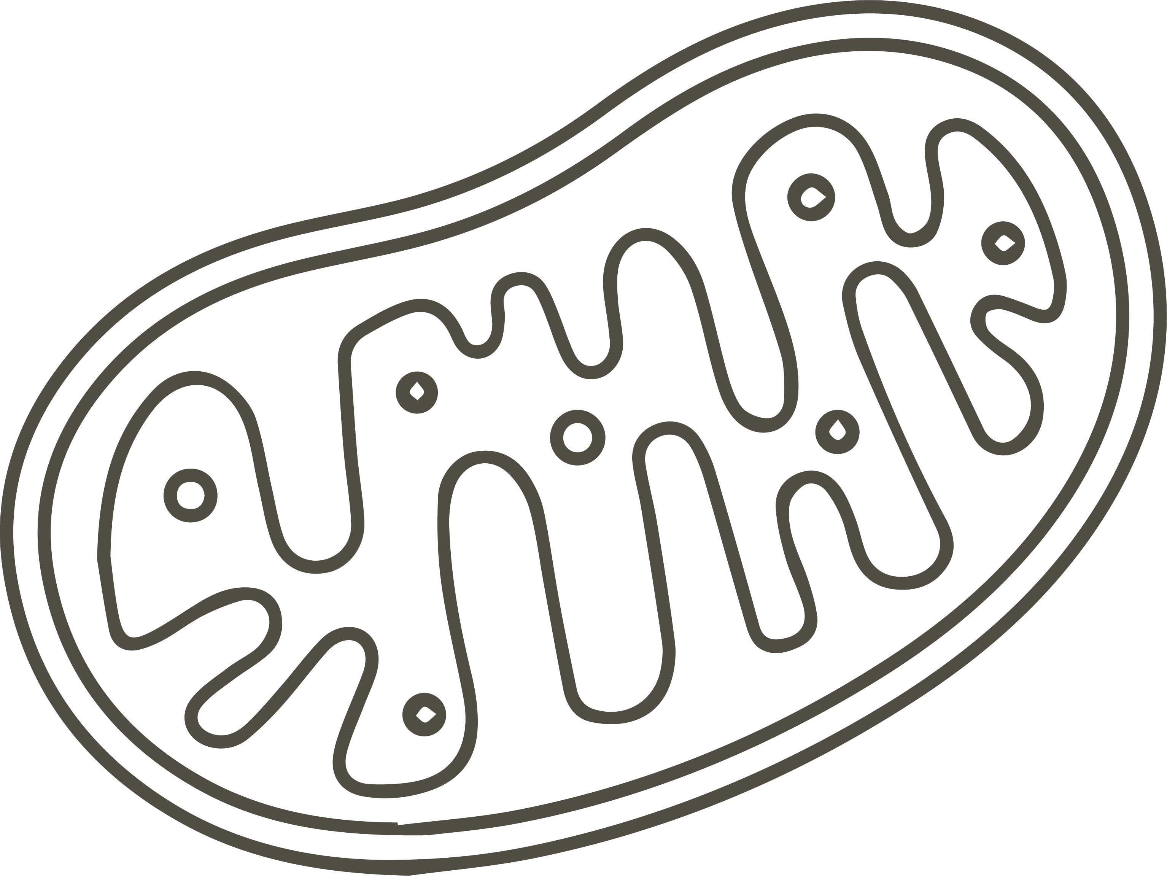
Final Project - Timing Novel Insertions in Acanthella Acuta mtDNA
Momin Ahmed

Slide 2
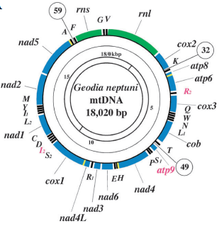
BACKGROUND
The mitochondrial DNA (mtDNA) among animals is typically a circular molecule
It is generally compact, with small intergenic regions and introns are typically absent
A notable exception to this is the clade medusozoa within the phylum Cnidaria
A typical Demosponge mitogenome from Geodia neptuni. Image courtesy of Lavrov et al. 2005.

Slide 3
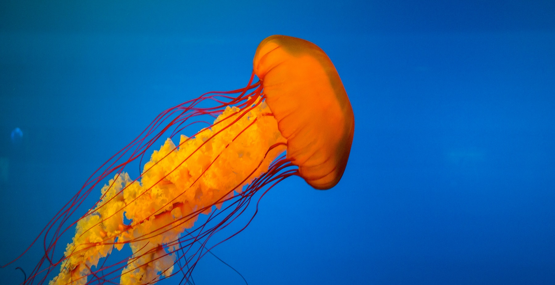
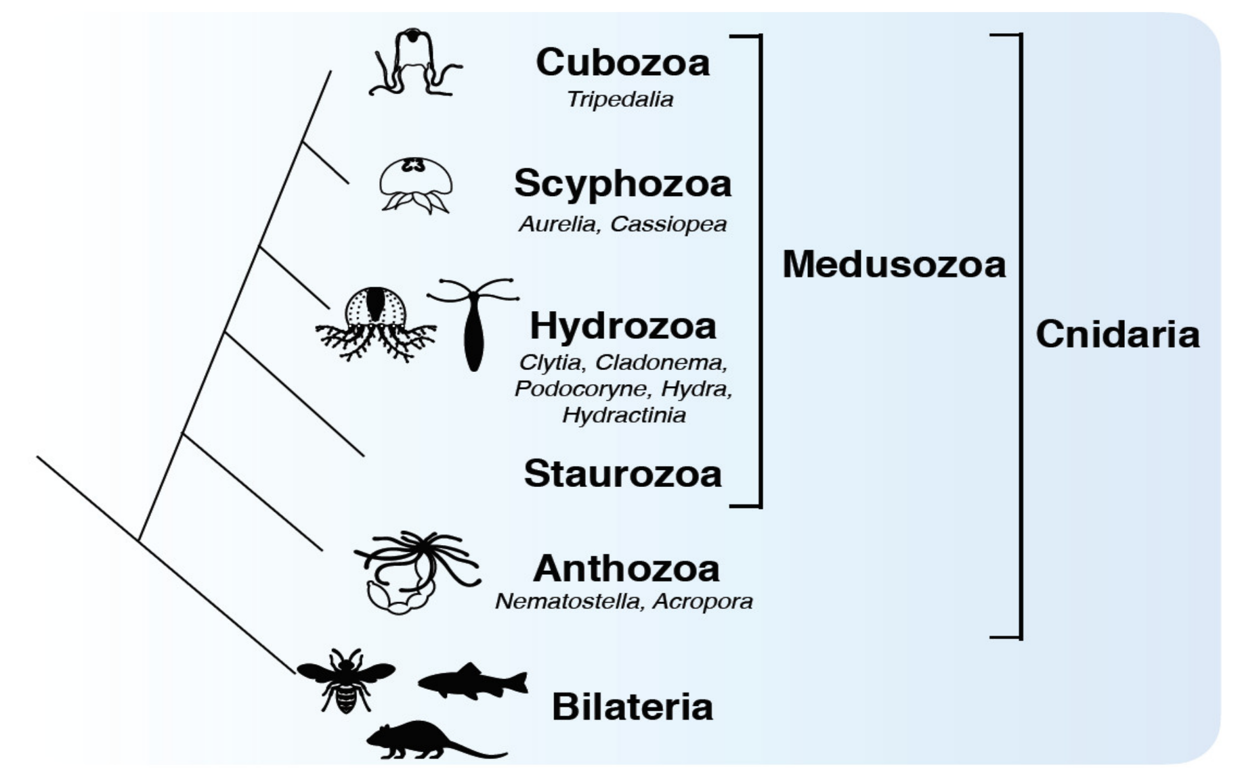
BACKGROUND
Medusozoa is a clade characterized by all its members having a medusoid form in some stage of their life
Medusozoa have been around since the Early Cambrian
Every member of this clade has linear mtDNA
Other exceptional features in this group's mtDNA include an open reading frame (ORF) resembling DNA polymerase and inverted terminal repeats (ITRs)
It is hypothesized that medusozoan mtDNA underwent linearization following the insertion of a linear plasmid that contained the ORF
Fujita et al. 2021

Slide 4
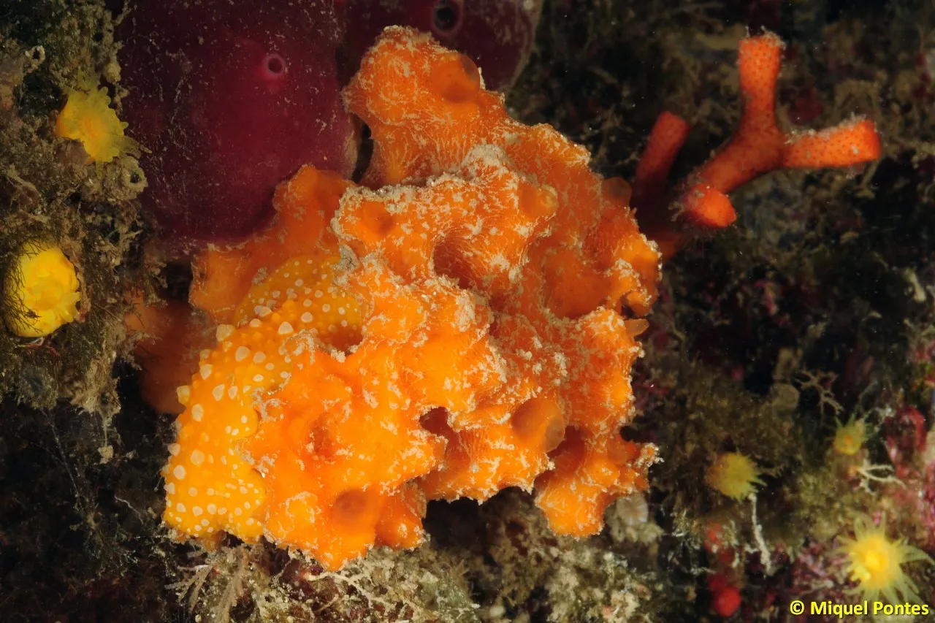
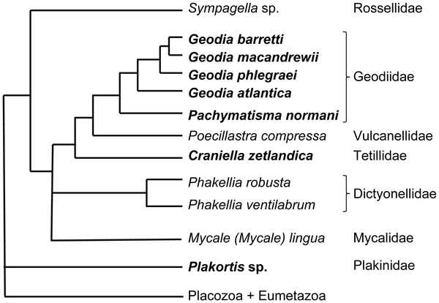
BACKGROUND
Acanthella acuta is a demosponge (phylum Porifera, family Dictyonellidae) commonly found within the Mediterranean Sea
Lavrov et al. (2019) included A. acuta in their survey of demosponge mtDNA from across different orders
They were unable to assemble the A. acuta mtDNA with a circular mapping
Using total DNA sequencing, multiple unusual features of the A. acuta mtDNA were revealed
Schöttner et al. 2012

Slide 5
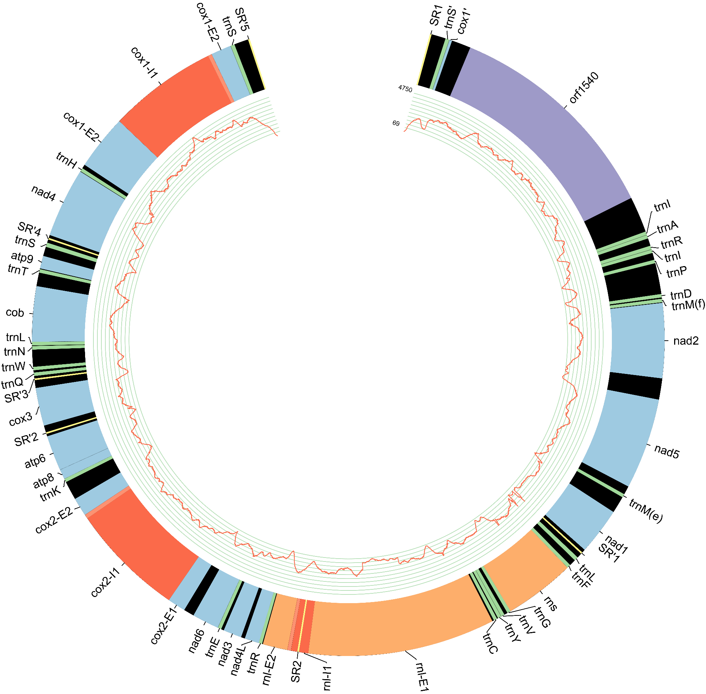
BACKGROUND
It was determined that the A. acuta mtDNA has a linear architecture, and is composed of one, unusually large mito-chromosome
It contains a large ORF (orf1540) which resembles DNA-directed DNA-polymerase (part 1) and DNA-directed RNA-polymerase (part 2)
There are group II introns within the genes encoding for cyclooxygenase subunits 1 and 2, and the large ribosomal subunit (cox1, cox2, and rnl)
It also has ITRs containing a copy of the tRNA gene for serine (tRNA(S)) and a portion of cox1.
Among these features, the ORF1540, the intron in cox2, and the ITRs are unique to A. acuta within demosponges
mtDNA of Acanthella acuta

Slide 6

GENERAL OBJECTIVE
The convergent appearance of a DNA-polymerase and ITRs in medusozoa and A. acuta may indicate that they may be linked to the linear arrangement of mtDNA
If these features arose in A. acuta by the insertion of a linear plasmid, it is possible that the other unique feature, i.e., the intron in the cox2 gene, entered the mitogenome from the same insertion event
Using molecular dating methods, it may be possible to determine a timeframe for when this insertion occurred
Determining the timing of these insertions may illustrate the relationship between these insertions and linear mtDNA

Slide 7


METHODS
PHYLOGENETIC ANALYSIS
Using NCBI BLAST, the top 100 most similar sequences to the introns in cox1, cox2 and rnl
Using top 50 for the orf1540 (parts 1 and 2) using UNIPROT BLAST
The samples were then filtered using CD-Hit with a threshold of 95% similarity
The sequences were aligned using the MAFFT tool on auto
Phylogenetic trees were constructed using RAxML-NG under the WAG model

Slide 8

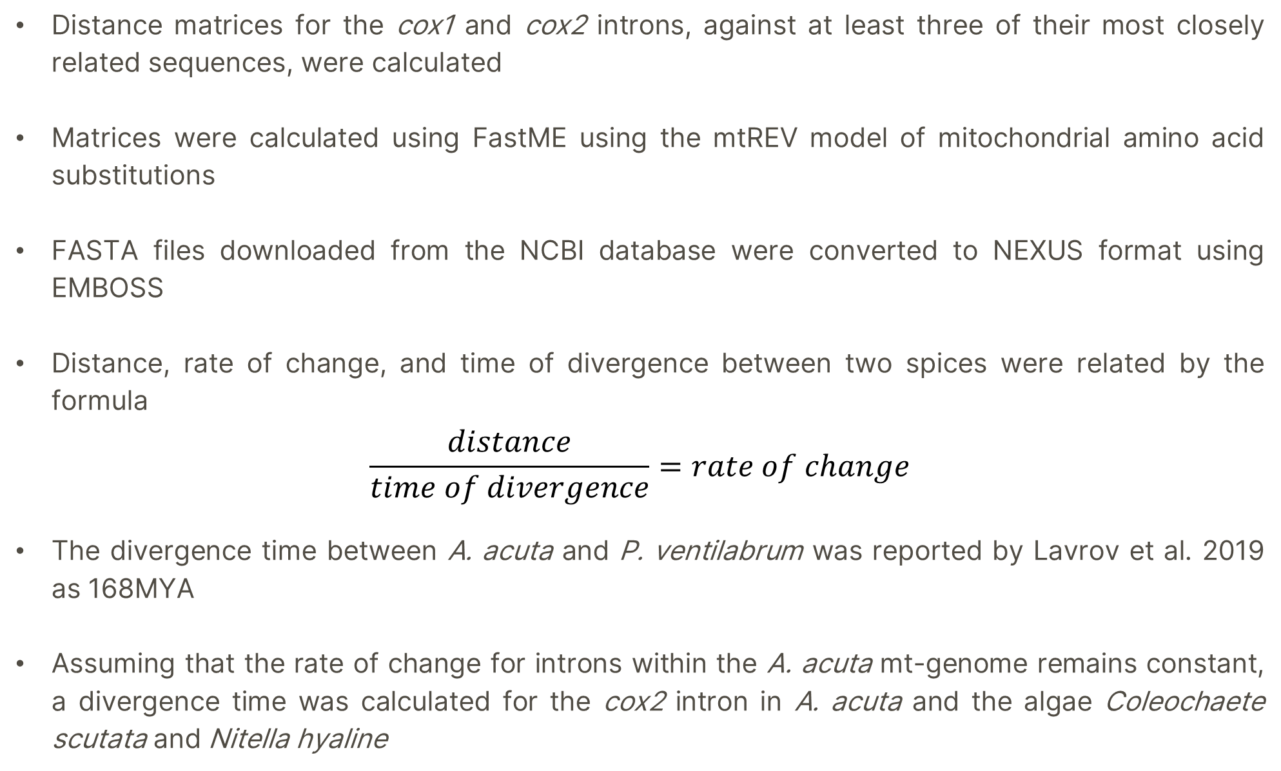
METHODS
DISTANCE AND DIVERGENCE TIME
Distance matrices for the cox1 and cox2 introns, against at least three of their most closely related sequences, were calculated
Matrices were calculated using FastME using the mtREV model of mitochondrial amino acid substitutions
FASTA files downloaded from the NCBI database were converted to NEXUS format using EMBOSS
Distance, rate of change, and time of divergence between two spices were related by the formula
$$\frac{distance}{time of divergence}=rate of change$$
The divergence time between A. acuta and P. ventilabrum was reported by Lavrov et al. 2019 as 168MYA
Assuming that the rate of change for introns within the A. acuta mt-genome remains constant, a divergence time was calculated for the cox2 intron in A. acuta and the algae Coleochaete scutata and Nitella hyaline
Notes:
For the introns says like are they acting like TEs at all

Slide 9
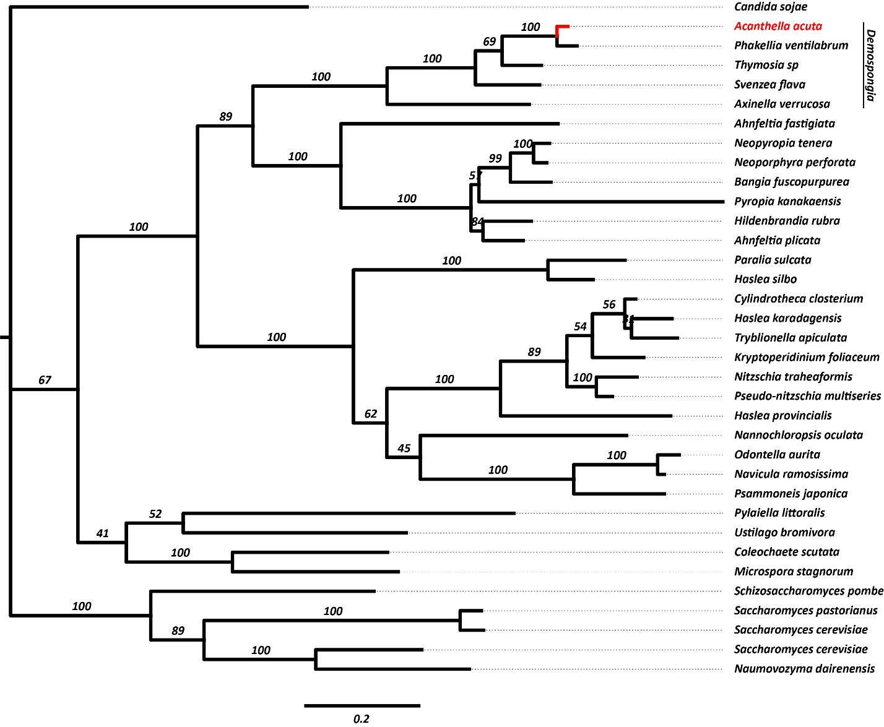
RESULTS & DISCUSSION
PHYLOGENETIC ANALYSIS
Maximum likelihood reconstruction of the intron within cox1 of the A. acuta reveals it is most closely related to an intron found in cox1 of Phakellia ventilabrum
All demosponges included in this analysis form a monophyletic clade, suggesting that the intron was vertically inherited by A. acuta
Bootstrap values of 200 replicates are shown.
Notes:
For the introns says like are they acting like TEs at all

Slide 10
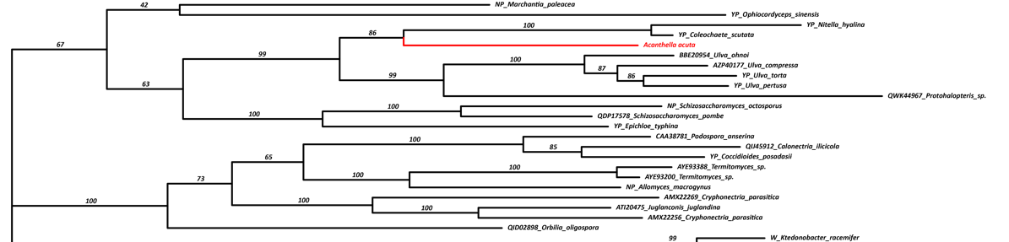
RESULTS & DISCUSSION
PHYLOGENETIC ANALYSIS
Maximum likelihood reconstruction of the intron within cox2 of the A. acuta reveals it is most closely related to an intron found in cox2 of the algae Coleachaete scutata and Nitella hyaline
The lack of representation of any closely related species to A. acuta could be an artifact of poor Poriferan mtDNA representation in the NCBI database or could suggest that the intron was acquired by A. acuta through horizontal gene transfer
Bootstrap values of 200 replicates are shown.
Notes:
For the introns says like are they acting like TEs at all

Slide 11
RESULTS
DISTANCES
cox1 distances | Acanthella acuta | Phakellia ventilabrum | Thymosia sp | Svenzea flava
Acanthella acuta | 0 | 0.0696 | 0.2729 | 0.3950
Phakellia ventilabrum | 0.0696 | 0 | 0.2992 | 0.4351
Thymosia sp | 0.2728 | 0.2992 | 0 | 0.3231
Svenzea flava | 0.3950 | 0.4351 | 0.3231 | 0
Notes:
For the introns says like are they acting like TEs at all

Slide 12
RESULTS
DISTANCES
cox2 distances | Acanthella acuta | Coleochaete scutata | Nitella hyalina | Ulva compres | Ulva ohnoi | Ulva pertusa | Ulva torta
Acanthella acuta | 0 | 1.3974 | 1.5495 | 1.5911 | 1.7075 | 1.5348 | 1.5668
Coleochaete scutata | 1.3974 | 0 | 0.3494 | 1.5431 | 1.6536 | 1.5681 | 1.7301
Nitella hyalina | 1.5496 | 0.3494 | 0 | 1.7617 | 1.7217 | 1.813 | 1.9375
Ulva compres | 1.5911 | 1.5431 | 1.7617 | 0 | 0.3973 | 0.3743 | 0.4020
Ulva ohnoi | 1.7075 | 1.6536 | 1.7217 | 0.3973 | 0 | 0.4081 | 0.4972
Ulva pertusa | 1.5348 | 1.5681 | 1.8130 | 0.3743 | 0.4081 | 0 | 0.3572
Ulva torta | 1.5668 | 1.7301 | 1.9375 | 0.4020 | 0.4972 | 0.3572 | 0
Notes:
For the introns says like are they acting like TEs at all

Slide 13
RESULTS & DISCUSSION
RATE OF CHANGE &DIVERGENCE TIME
The rate of change between A. acuta and P. ventilabrum was calculated to be 4.14553516x10^-10 substitutions/year
The divergence time between A. acuta and C. scutata was calculated to be 3.37 x 10^9 years
This divergence time is too far in the distant past to be accurate
This large divergence time suggests that the assumed constant rate of evolution for introns in the A. acuta mitogenome might be invalid
It is also possible that the rate of evolution within C. scutate is accelerated.
A more likely cause of this is that mtREV is based on vertebrate mitochondrial amino acids substitutions, and therefore its application on algae might result in an incorrect distance matrix.
Unfortunately, because of this inaccurate result, it is impossible to make any inferences about the relationship of the timing of these events, and their relationship with linear mtDNA
Notes:
For the introns says like are they acting like TEs at all

Slide 14

REFERENCES
Lavrov D. V., Pett W. 2016. Animal mitochondrial DNA as we do not know it: Mt-Genome Organization and Evolution in Nonbilaterian Lineages. Genome Biol. Evol. 8:2896–2913.
Lavrov D. V., Pett W., Voigt O., Wörheide G., Forget L., Lang B.F., Kayal E. 2013. Mitochondrial DNA of clathrina clathrus (Calcarea, Calcinea): Six linear chromosomes, fragmented rRNAs, tRNA editing, and a novel genetic code. Mol. Biol. Evol. 30:865–880.
Lavrov D. V, Maldonado M., Perez T., Morrow C. 2019. Phylogenetic relationships of heteroscleromorph demosponges and the affinity of the genus Myceliospongia (Demospongiae incertae sedis). bioRxiv.:793372.
Lubośny M., Śmietanka B., Lasota R., Burzyński A. 2022. Confirmation of the first intronic sequence in the bivalvian mitochondrial genome of Macoma balthica (Linnaeus, 1758). Biol. Lett. 18:20220275.
Mouhamadou B., Barroso G., Labare J. 2004. Molecular evolution of a mitochondrial polB gene , encoding a family B DNA polymerase , towards the elimination from Agrocybe mitochondrial genomes. :257–263.
Paysan-Lafosse T., Blum M., Chuguransky S., Grego T., Pinto B.L., Salazar G.A., Bileschi M.L., Bork P., Bridge A., Colwell L., Gough J., Haft D.H., Letunić I., Marchler-Bauer A., Mi H., Natale D.A., Orengo C.A., Pandurangan A.P., Rivoire C., Sigrist C.J.A., Sillitoe I., Thanki N., Thomas P.D., Tosatto S.C.E., Wu C.H., Bateman A. 2023. InterPro in 2022. Nucleic Acids Res. 51:D418–D427.
Richter S., Schwarz F., Hering L., Böggemann M., Bleidorn C. 2015. The utility of genome skimming for phylogenomic analyses as demonstrated for glycerid relationships (annelida, glyceridae). Genome Biol. Evol. 7:3443–3462.
Smith D.R., Keeling P.J. 2015. Mitochondrial and plastid genome architecture: Reoccurring themes, but significant differences at the extremes. Proc. Natl. Acad. Sci. U. S. A. 112:10177–10184.
Vallès Y., Halanych K.M., Boore J.L. 2008. Group II introns break new boundaries: Presence in a bilaterian's genome. PLoS One. 3:1–6.
Bernardino A.F., Li Y., Smith C.R., Halanych K.M. 2017. Multiple introns in a deep-sea Annelid (Decemunciger: Ampharetidae) mitochondrial genome. Sci. Rep. 7:1–8.
Bridge D., Cunningham C.W., Schierwater B., DeSalle R., Buss L.W. 1992. Class-level relationships in the phylum Cnidaria: Evidence from mitochondrial genome structure. Proc. Natl. Acad. Sci. U. S. A. 89:8750–8753.
Burger G., Yan Y., Javadi P., Lang B.F. 2009. Group I-intron trans-splicing and mRNA editing in the mitochondria of placozoan animals. Trends Genet. 25:381–386.
Doublet V., Raimond R., Grandjean F., Lafitte A., Souty-Grosset C., Marcadé I. 2012. Widespread atypical mitochondrial DNA structure in isopods (Crustacea, Peracarida) related to a constitutive heteroplasmy in terrestrial species. Genome. 55:234–244.
Gray M.W., Burger G., Lang B.F. 1999. Mitochondrial evolution. Science (80-. ). 283:1476–1481.
Gray M.W., Lang B.F., Burger G. 2004. Mitochondria of protists. Annu. Rev. Genet. 38:477–524.
Gualberto J.M., Mileshina D., Wallet C., Niazi A.K., Weber-Lotfi F., Dietrich A. 2014. The plant mitochondrial genome: Dynamics and maintenance. Biochimie. 100:107–120.
Huchon D., Szitenberg A., Shefer S., Ilan M., Feldstein T. 2015. Mitochondrial group I and group II introns in the sponge orders Agelasida and Axinellida. BMC Evol. Biol.:1–14.
Jenkins H.L., Graham R., Porter J.S., Vieira L.M., de Almeida A.C.S., Hall A., O’Dea A., Coppard S.E., Waeschenbach A. 2022. Unprecedented frequency of mitochondrial introns in colonial bilaterians. Sci. Rep. 12:1–14.
Kayal E., Bentlage B., Collins A.G., Kayal M., Pirro S., Lavrov D. V. 2012. Evolution of linear mitochondrial genomes in medusozoan cnidarians. Genome Biol. Evol. 4:1–12.
Lavrov D. V., Adamski M., Chevaldonné P., Adamska M. 2016. Extensive Mitochondrial mRNA Editing and Unusual Mitochondrial Genome Organization in Calcaronean Sponges. Curr. Biol. 26:86–92.
Lavrov D. V., Maikova O.O., Pett W., Belikov S.I. 2012. Small inverted repeats drive mitochondrial genome evolution in Lake Baikal sponges. Gene. 505:91–99.

